Slide 1
Instant Messaging System
Mert Gulmus - 211ADB070

Slide 2
Idea
An app that allows users to instantly exchange text messages
No third-party integrations
No phone number required
Multi-platform, web based system

Slide 3
Tech stack
FE
BE
DB
ReactJS
Node JS + Express
SPA, easy to implement
Single programming language
MongoDB
High-speed, scalable and flexible

Slide 4
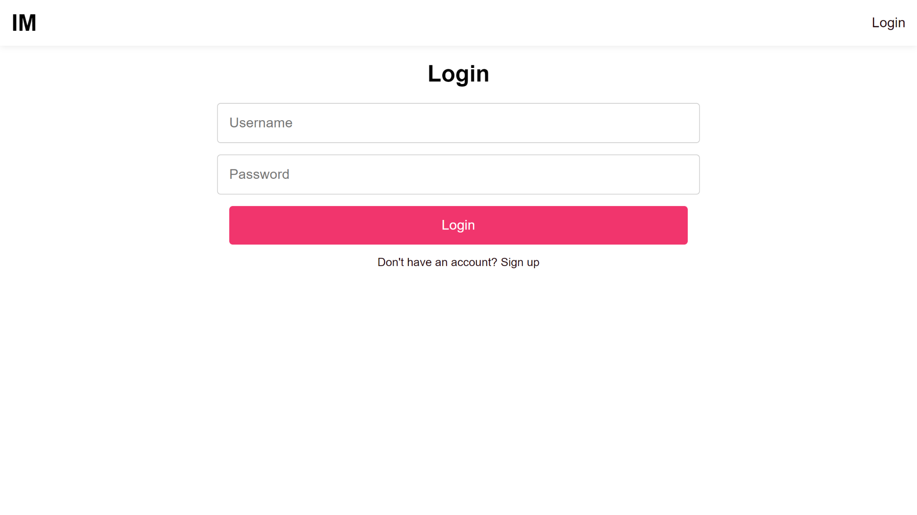
Login screen

Slide 5
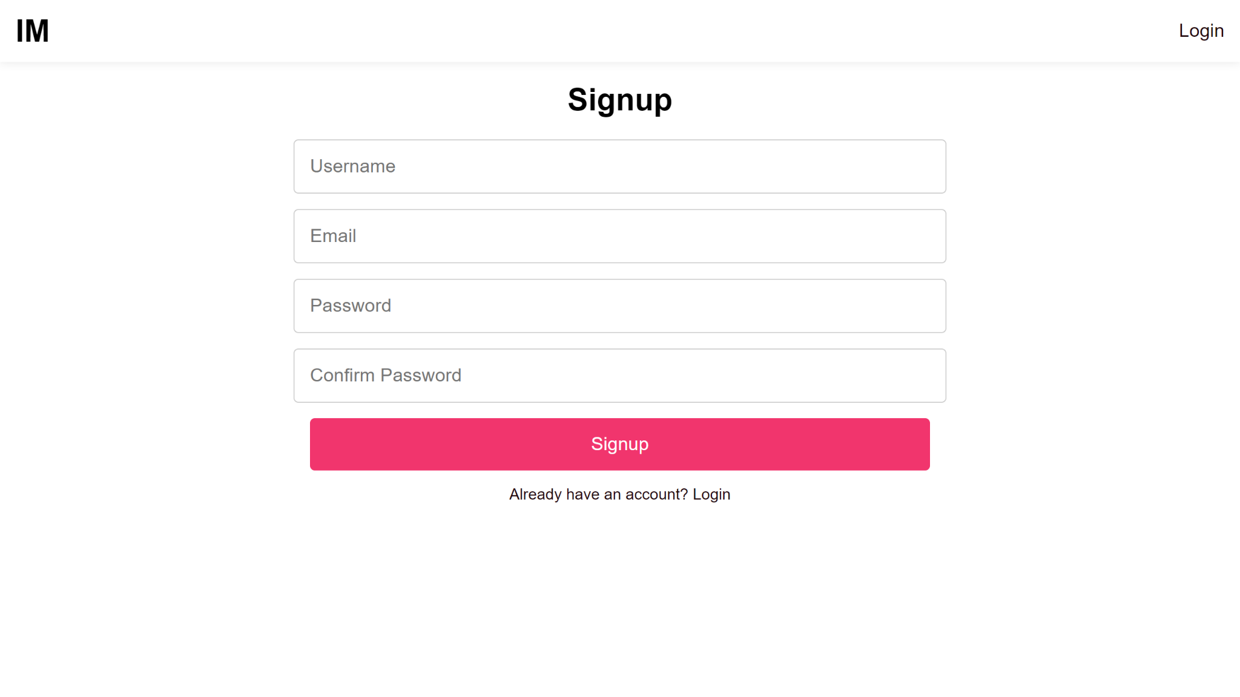
Signup screen

Slide 6
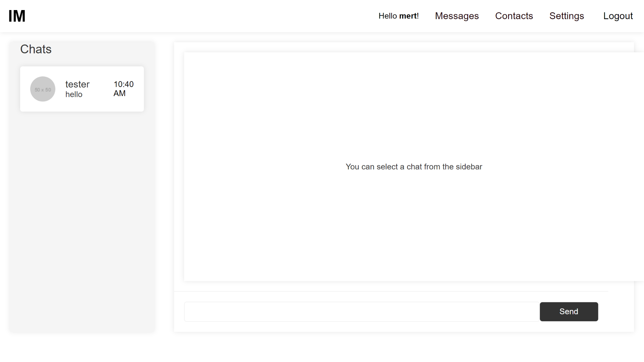
Homepage

Slide 7
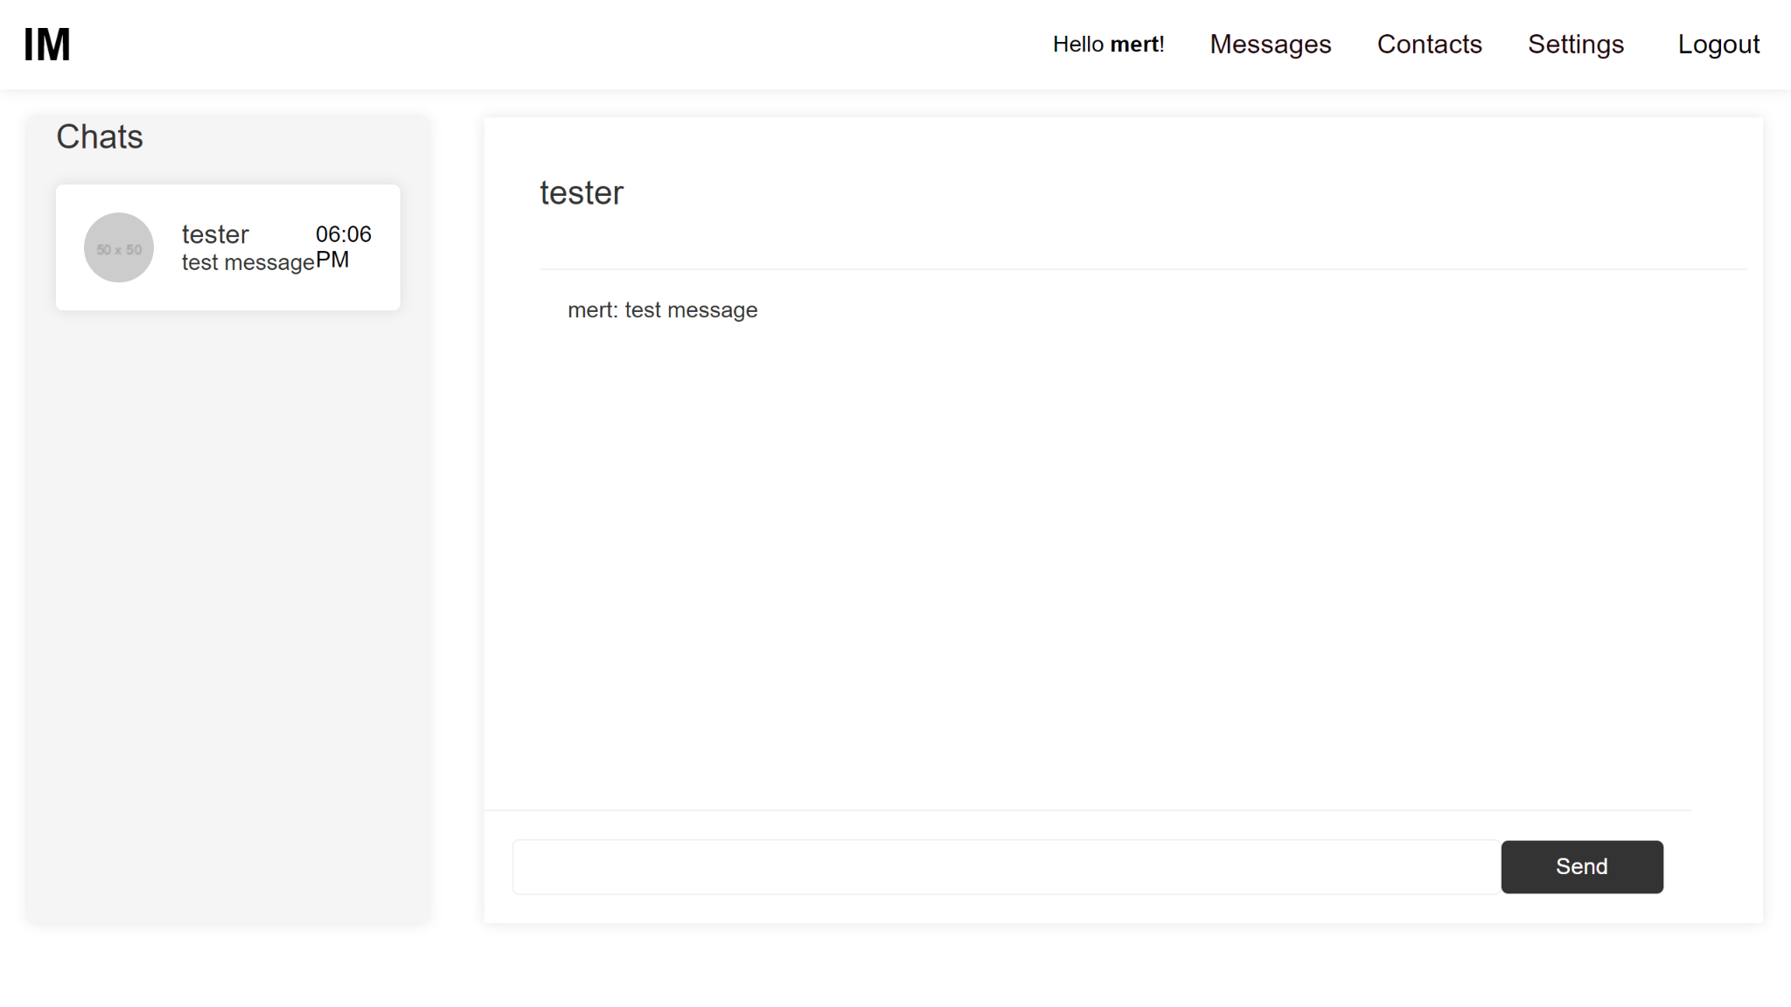
Chat screen

Slide 8
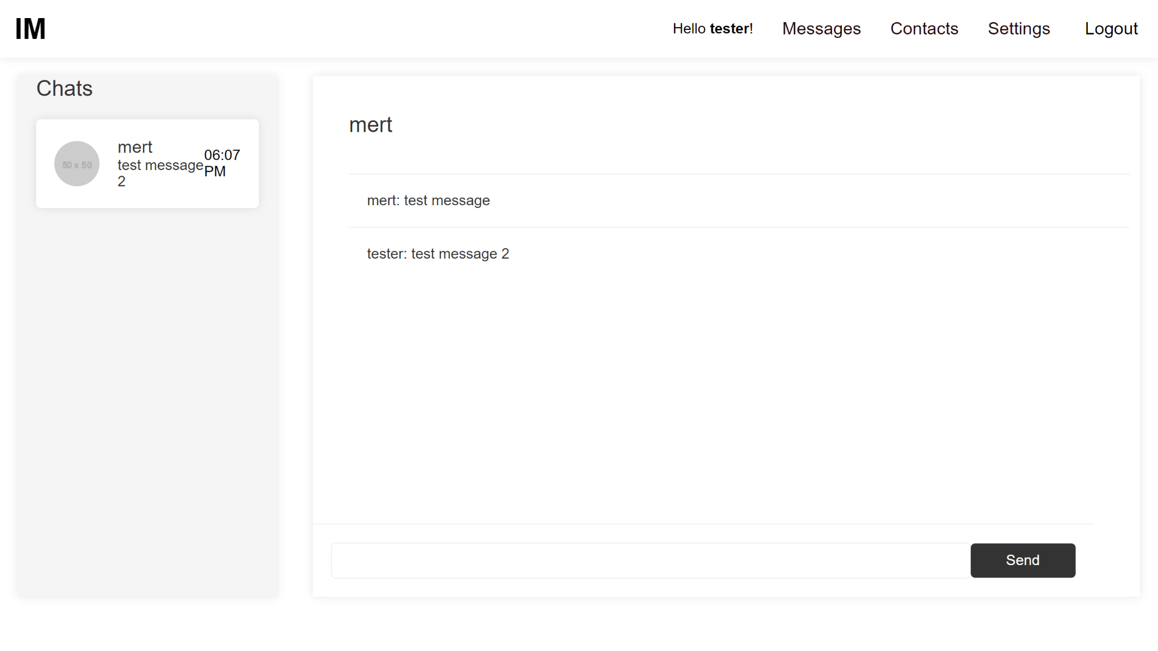
Exchanged messages

Slide 9
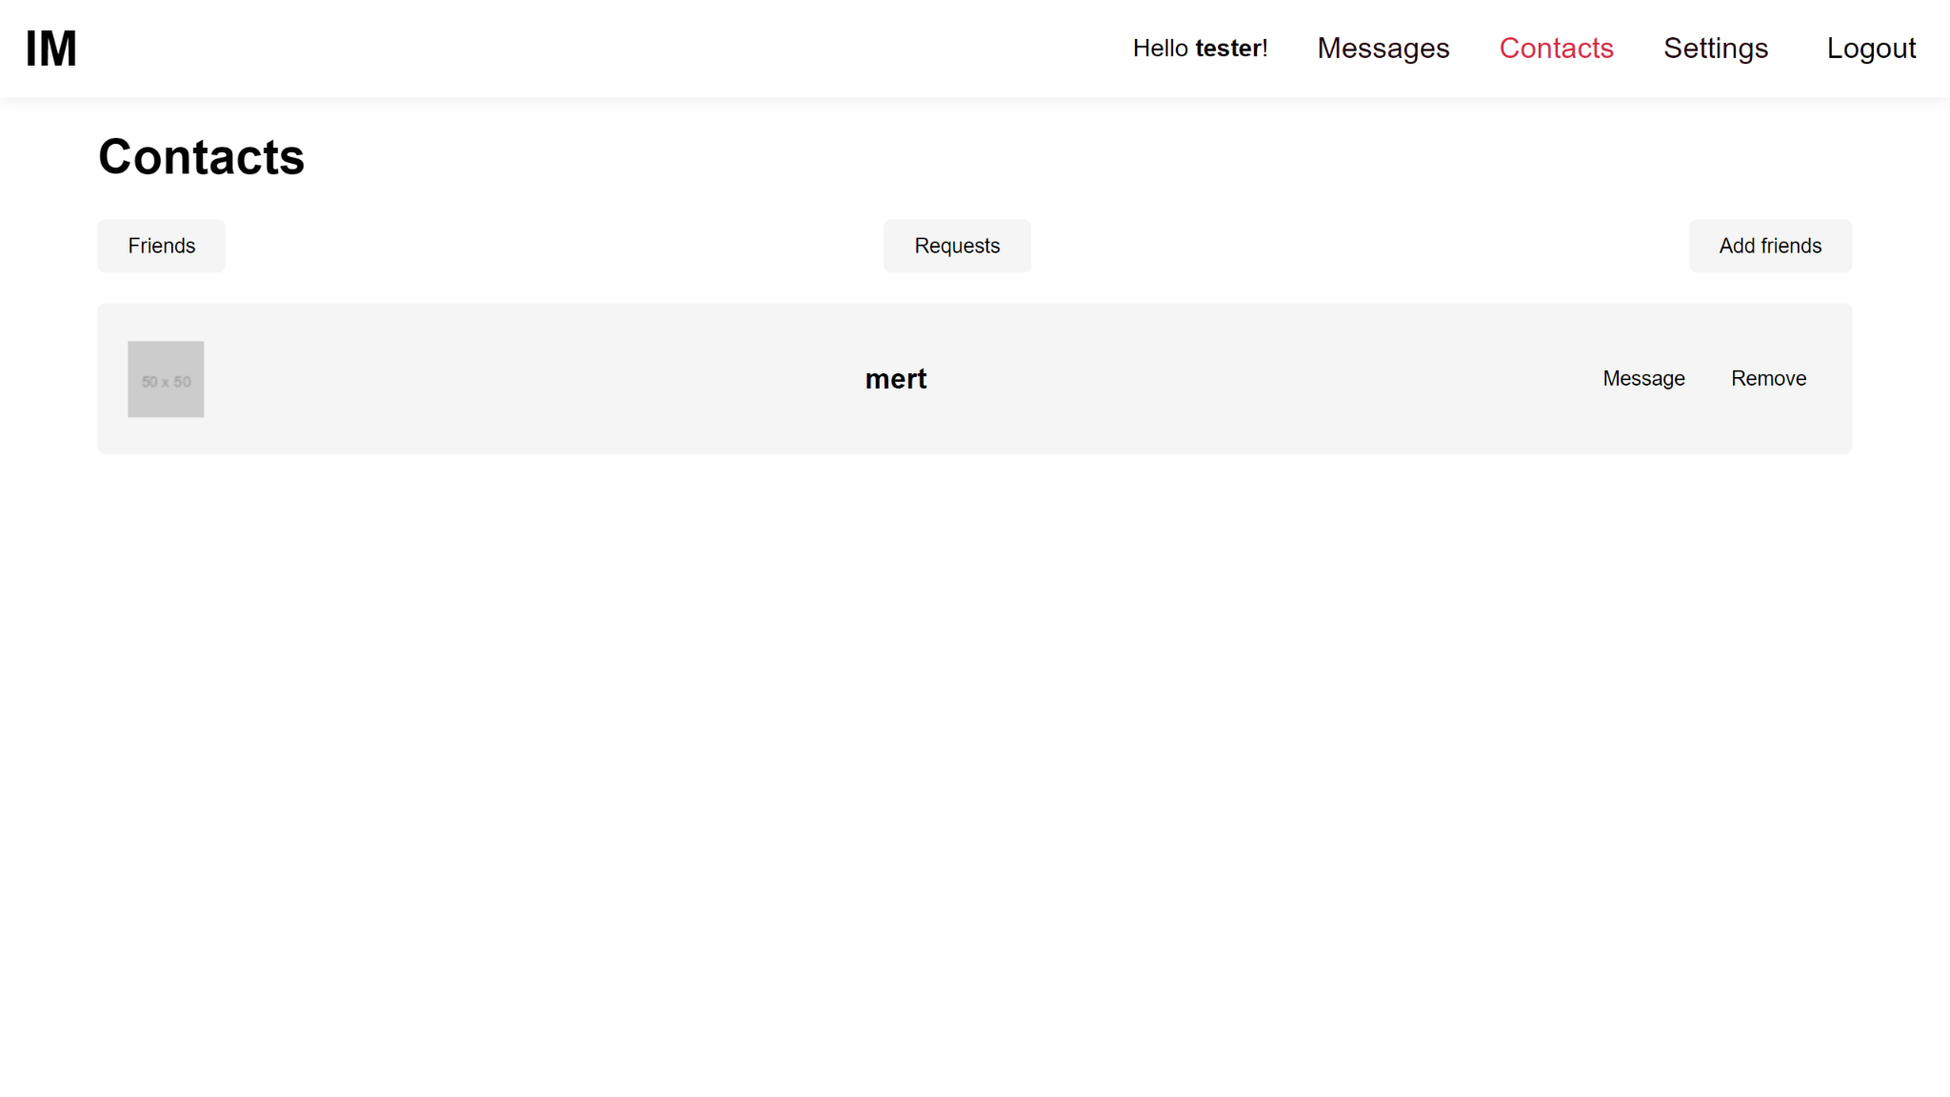
Contacts

Slide 10
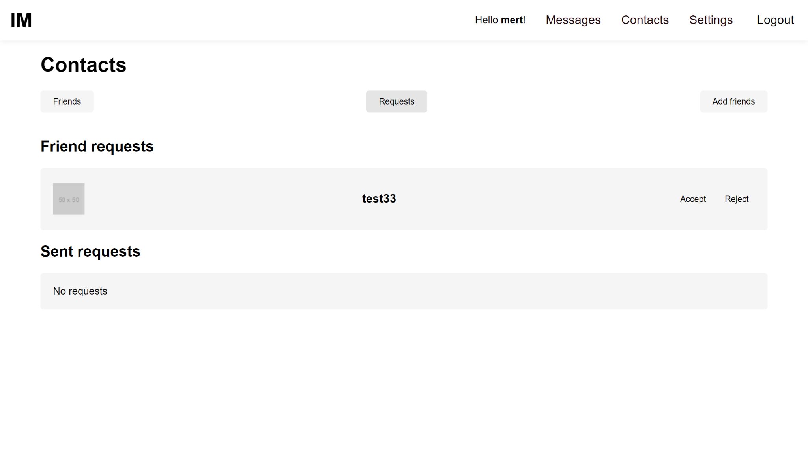
Friend requests

Slide 11
Issues
State management
Data consistency
NoSQL integration

Slide 12
Thanks for your attention! :)

